Slide 1
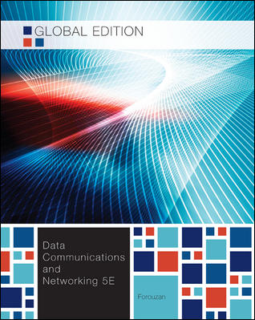
Chapter 14
Other Wired Networks

Slide 2
14장: Objective
14.1 Telephone Network
  The telephone network as a voice network.
  How the voice network has been used for data transmission either as a dial-up or DSL service.
14.2 Cable Network
  The cable network as a video network.
  How the video network has been used for data transmission.
14.3 SONET
  SONET, both as a fiber-optic technology and a network.
  How the technology can be used for high-speed connection to carry data.
Notes:
1.#

Slide 3
14장: Objective
14.4 ATM
  ATM use SONET as the carrier to create a high-speed wide area network(WAN).
  ATM is a cell-relay network that uses a fixed-size frame (cell) as the unit of transmitted data.
14.5 요약
Notes:
1.#

Slide 4
14.1 Telephone Network
The telephone network had its beginnings in the late 1800s.
The entire network was originally an analog system using analog signals to transmit voice.
With the advent of the computer era, the network, in the 1980s, began to carry data in addition to voice.
During the last decade, the telephone network has undergone many technical changes.
The network is now digital as well as analog.

Slide 5
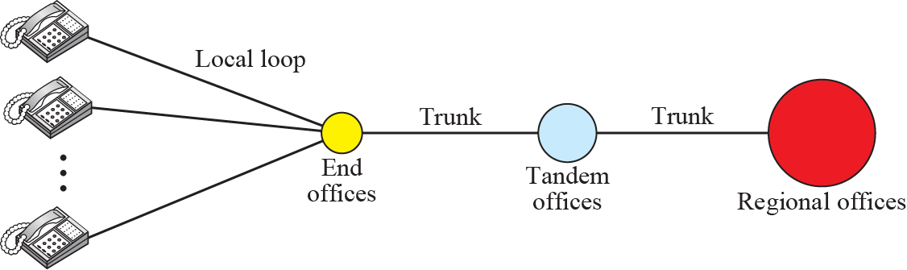
14.1.1 Major Components
A telephone System
  Local Loop : a twisted pair cable that connects telephone to nearest end office or local central office.
  Trunk : Office 사이의 통신을 담당하는 전송매체
  Switching Office : A switch connects several local loops or trunks.

Slide 6
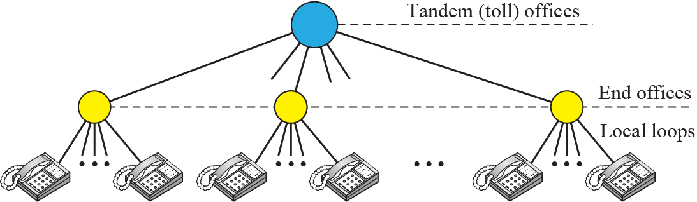
14.1.2 LATA
Local Access Transport Area (LATA)
  LATA is a term used in U.S. telecommunications regulation.
  It represents a geographical area of the United.
    Intra-LATA Service : Local Exchange Carrier(LEC)
    Inter-LATA Service : Inter-exchange Carrier(IXC)
Switching Office in a LATA

Slide 7
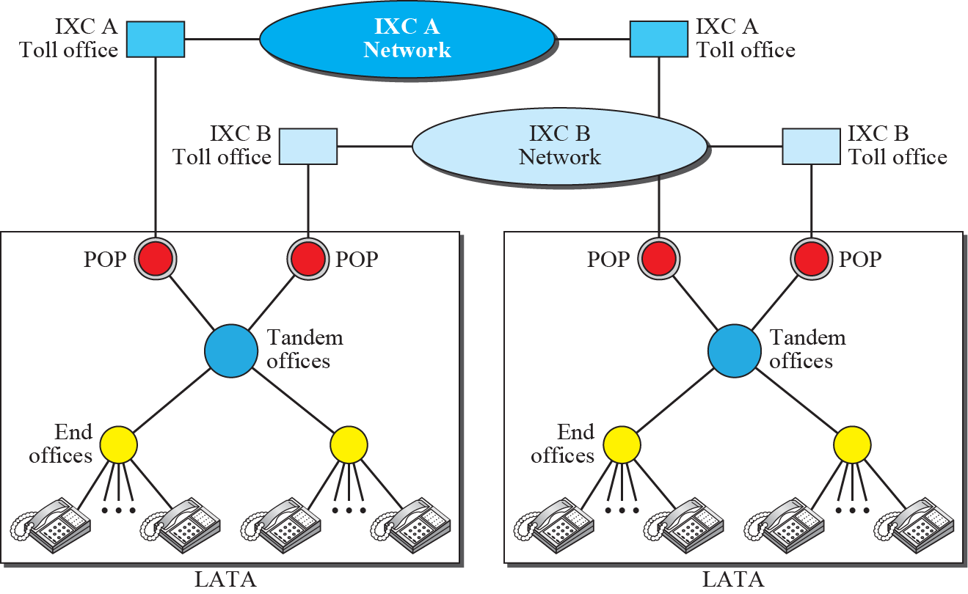
14.1.2 LATA
Point of Presence(POP)

Slide 8
14.1.3 Signaling
In-band Signaling
  Signaling과 실제 통화가 동일한 회선(4kHz 음성 채널)에서 사용
Out-of-band Signaling
  음성 채널의 일부를 할애하여 Signaling에 사용
현대 전화 네트워크에서는 데이터 전송 임무와
통화 연결(Signaling ) 임무는 분리되어 있다.
데이터 전송은 한 네트워크에 하고
통화 연결은 다른 네트워크에서 한다.

Slide 9
14.1.3 Signaling
Data Transfer Network
  Data Transfer Network witch can carry multimedia information is circuit-switched network.
  It can be a packet-switched network.
Signaling Network
  OSI 모델이나 Internet 모델과 유사한 구조로 되어 있는 packet-switched network.
  전화 번호를 전달하는데 필요한 정보는 오류제어와 주소정보와 함께 Packet 속에 Encapsulation 됨

Slide 10
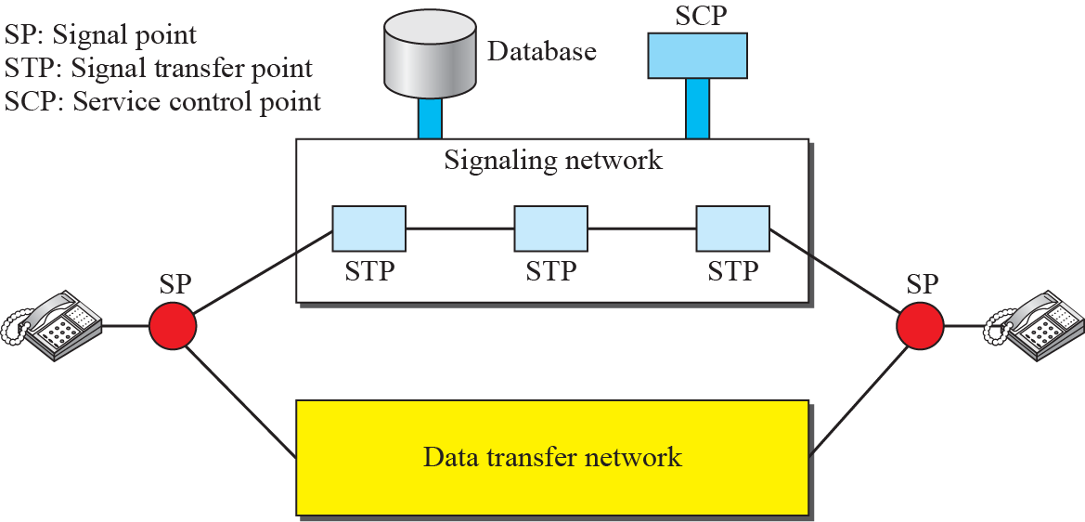
14.1.3 Signaling
Data Transfer and Signaling Network

Slide 11
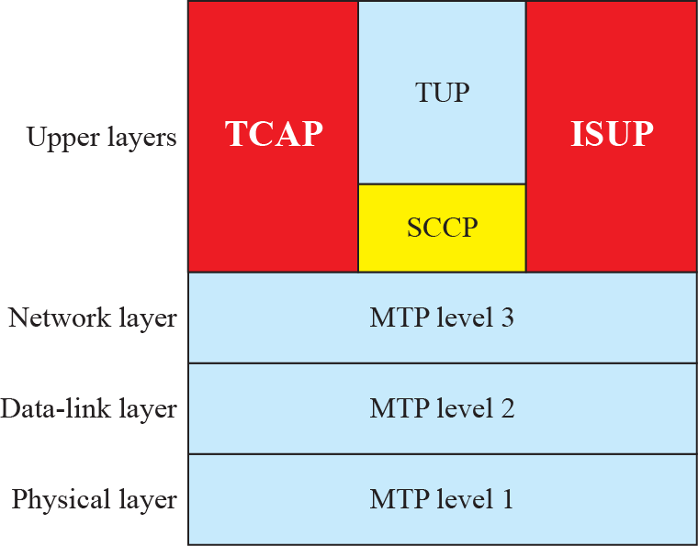
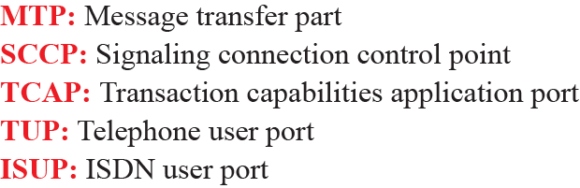
14.1.3 Signaling
Signaling System Seven(SS7)
  The protocol that is used in the signaling network is SS7.
  SS7의 계층 구조

Slide 12
14.1.4 Services by Telephone Networks
Analog Services
  Analog Switched Services : Dial-up services. The signal on a local loop is analog.
  Analog Leased Services : Customers can lease a line, and it is dedicated to them.
Digital Services
  Digital Services are less sensitive than analog services to noise and other form of interference.
  Switched/56 Service : Digital version of analog switched line (56Kbps)
  Digital Data Service : Digital version of analog leased line (64Kbps)

Slide 13
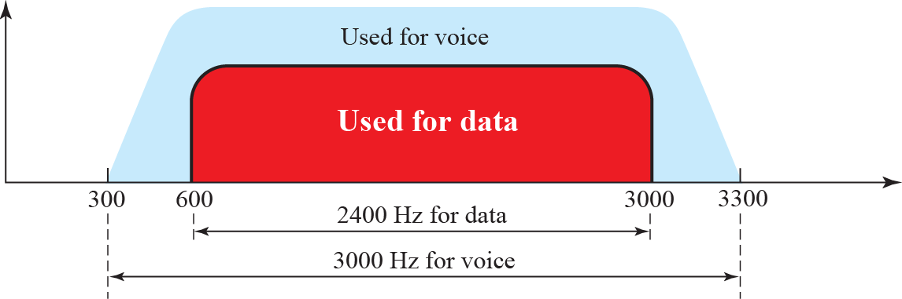
14.1.5 Dial-up Services
Traditional telephone lines can carry frequencies between 300 and 3300 Hz, giving them a bandwidth of 3000 Hz.
A dial-up service uses a modem to send data through telephone lines.

Slide 14
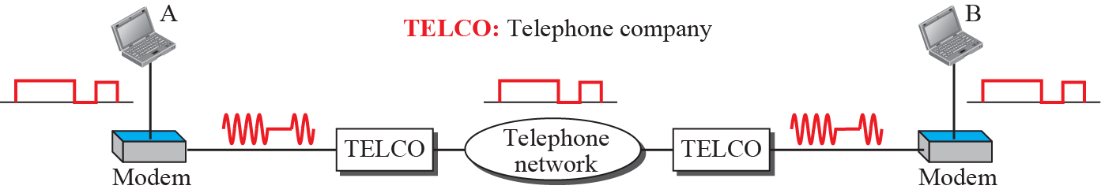
14.1.5 Dial-up Services
Modem
  The term modem is a composite word that refers to the two functional entities that make up the device: a signal modulator and a signal demodulator.
Modulation/Demodulation

Slide 15
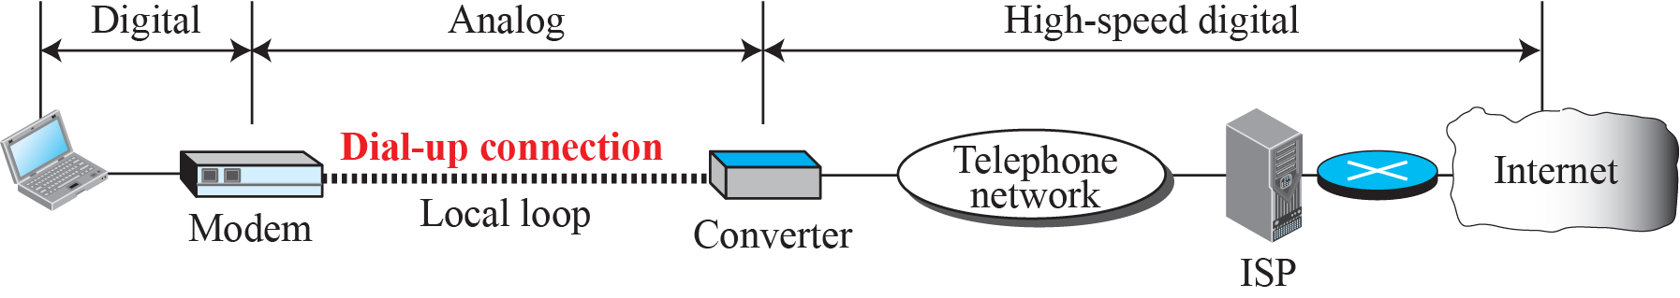
14.1.5 Dial-up Services
Dial-up network to provide Internet access

Slide 16
14.1.6 Digital Subscriber Line(DSL)
Digital Subscriber Line(DSL)
  After traditional modems reached their peak data rate, telephone companies developed another technology.
  DSL technology is supporting high-speed digital communication over existing telephone.
  DSL technology is a set of technologies, each differing in the first letter (ADSL, VDSL, HDSL, and SDSL).
  Asymmetric DSL
    High speed in downstream, Low speed in upstream
    Available bandwidth is divided unevenly for down/up stream.

Slide 17
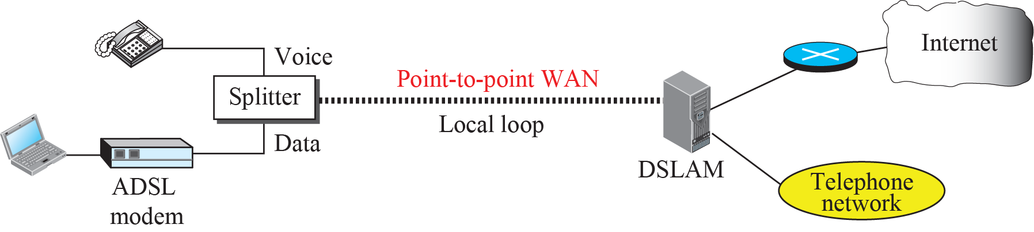
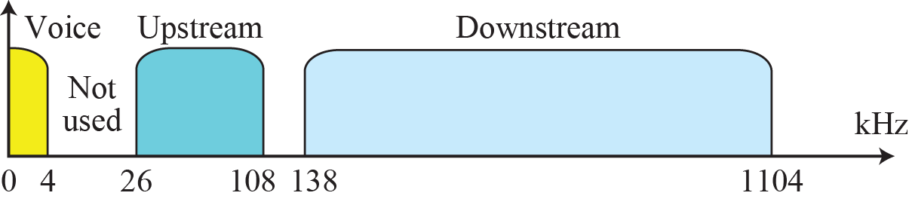
14.1.6 Digital Subscriber Line(DSL)
ADSL point-to-point Network

Slide 18
14-2 CABLE NETWORK
The cable networks became popular with people who just wanted a better signal.
Cable TV started to distribute broadcast video signals to locations with poor or no reception in the late 1940s.
Cable TV also found a good market in Internet access provision, using some of the channels originally designed for video.

Slide 19
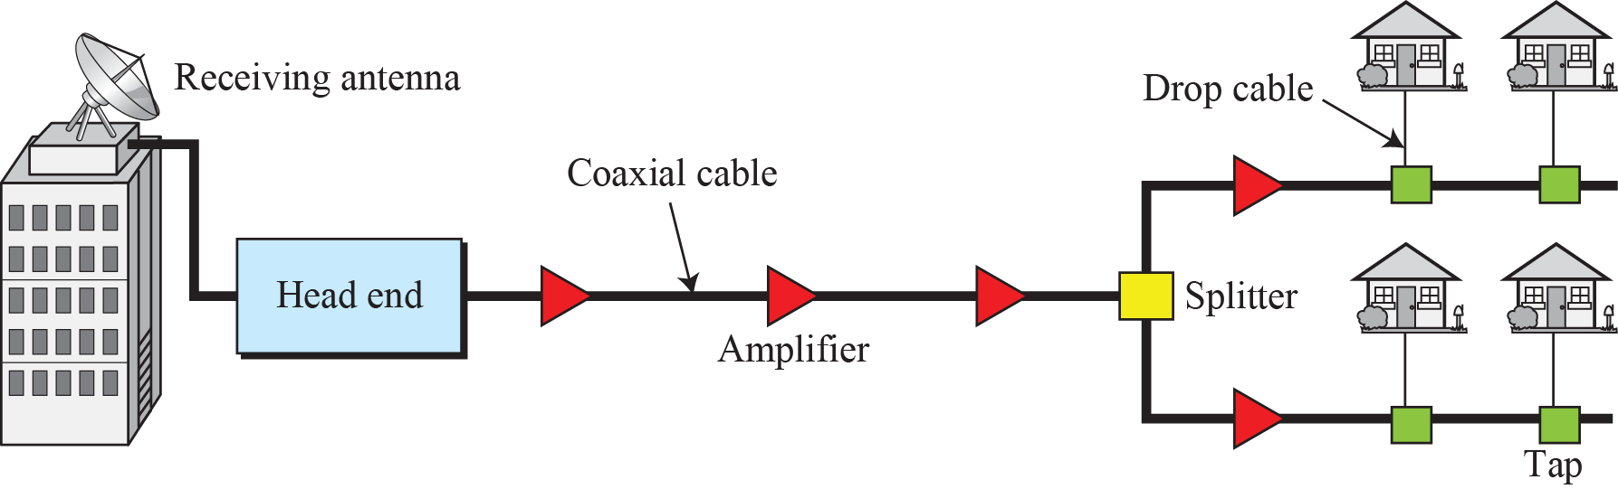
14.2.1 Traditional Cable Networks
Cable TV was called community antenna television (CATV)
Traditional Cable Networks
  An antenna at the top of a tall hill or building receives the signals from the TV stations and distributes them, via coaxial cables, to the community.

Slide 20
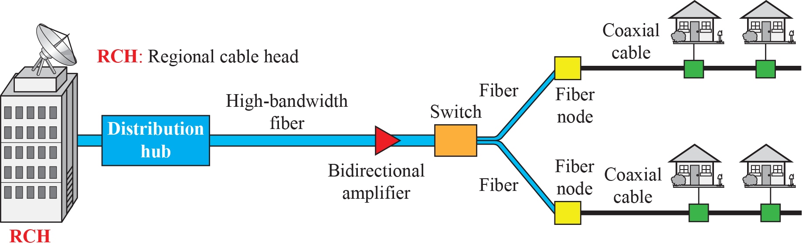
14.2.2 HFC Network
Hybrid Fiber-Coaxial Network (HFC)
  The second generation of cable network
  The network uses a combination of fiber-optic and coaxial cable.

Slide 21
14.2.3 Cable TV for Data Transfer
DSL technology provides high-data-rate connections for residential subscribers over the local loop.
However, DSL uses the existing unshielded twisted-pair cable, which is very susceptible to interference.
  This imposes an upper limit on the data rate.
A solution is the use of the cable TV network.

Slide 22
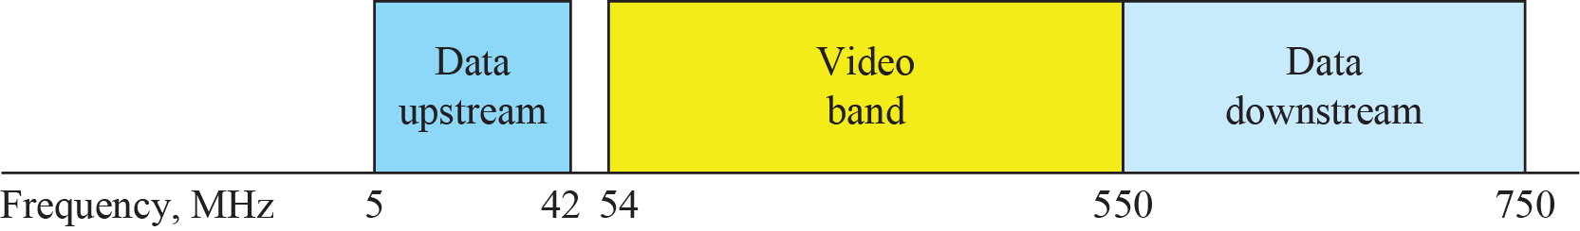
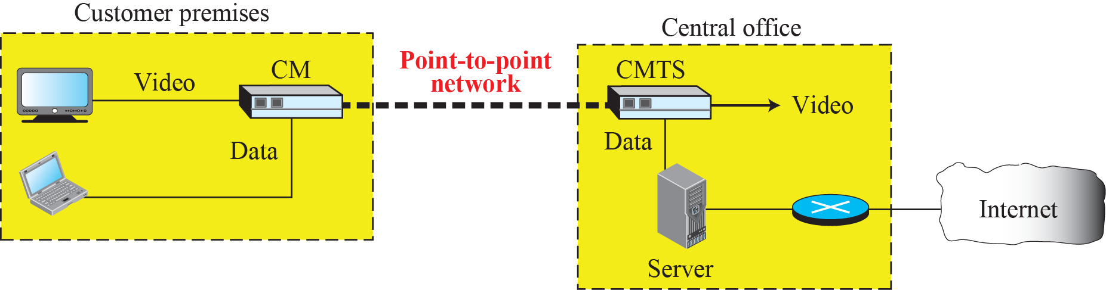
14.2.3 Cable TV for Data Transfer
Division of coaxial cable band by CATV
Cable modem transmission system (CMTS)
  CM : Cable Modem
  CMTS : Cable Modem Transmission System

Slide 23
14-3 SONET
Synchronous Optical Network(SONET)
  SONET and SDH are standardized protocols that transfer multiple digital bit streams synchronously over optical fiber using lasers or light from LEDs.
  SONET is a set of transport containers that allow for delivery of a variety of protocols, including telephony, ATM, Ethernet, and TCP/IP traffic.
Synchronous Digital Hierarchy(SDH)
  SONET/SDH is not a communications protocol in itself, but a transport protocol.
  SONET and SDH are essentially the same.

Slide 24
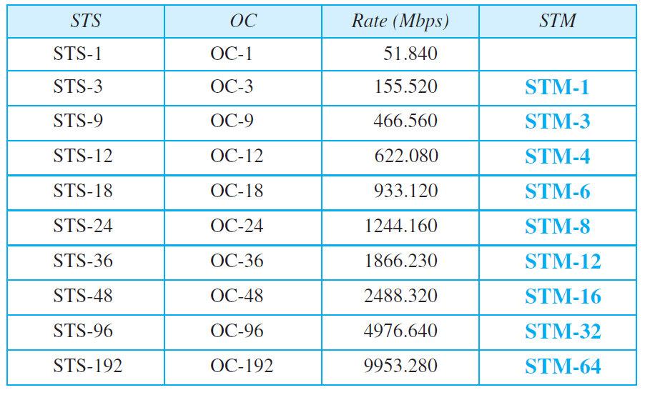
14.3.1 Architecture
Signal
  Synchronous Transport Signal (STS)
  Optical Carrier (OC)
  Synchronous Transport Module (STM)
SONET/SDH Data Rate

Slide 25
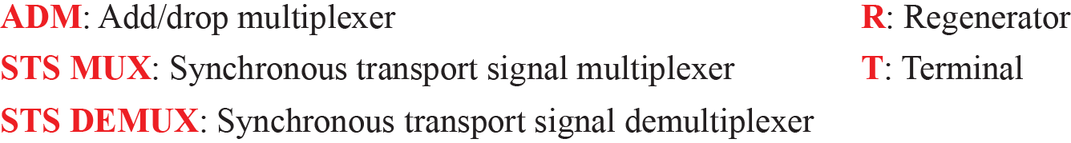
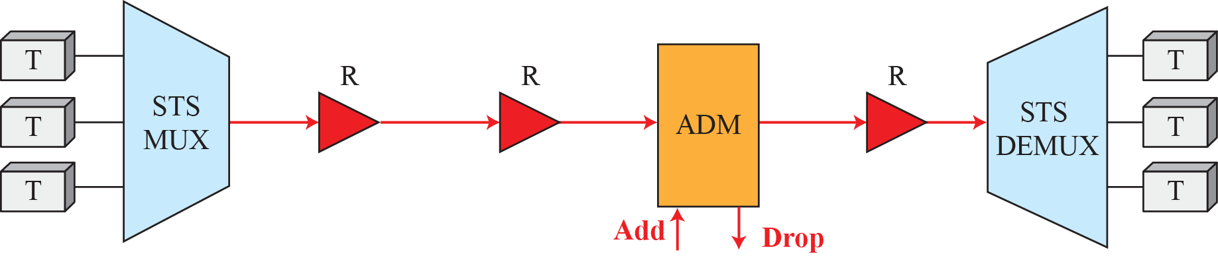
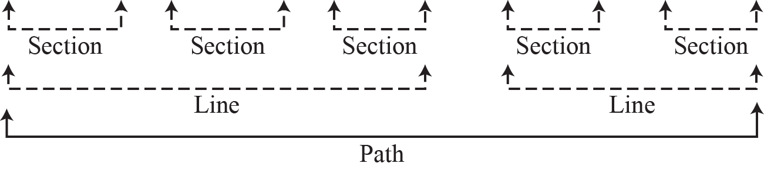
14.3.1 Architecture
A simple network using SONET equipment

Slide 26
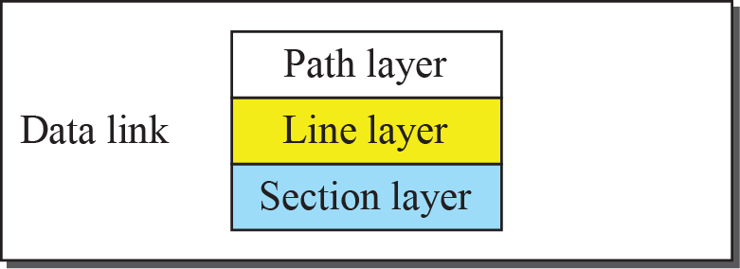
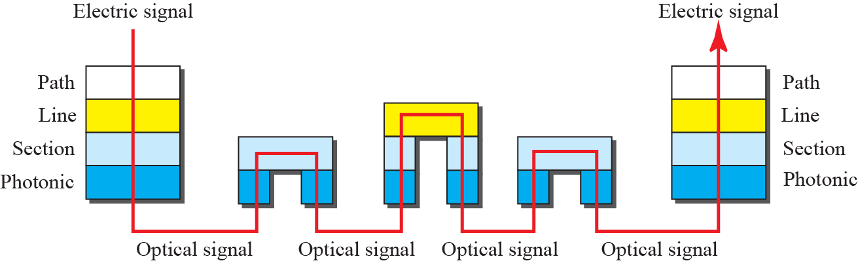
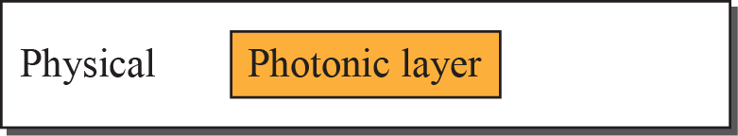
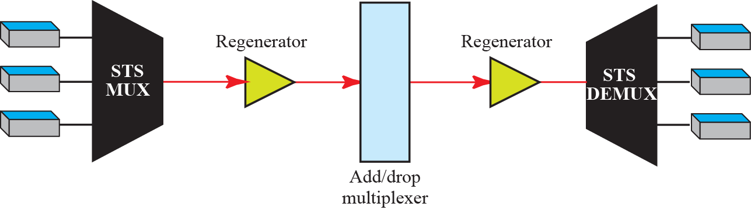
14.3.2 SONET Layers
SONET layers compared with OSI or the Internet layers
The SONET includes four functional layers:
photonic, section, line, and path layer.

Slide 27
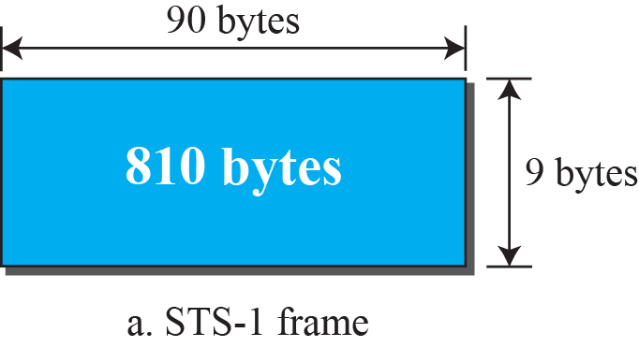
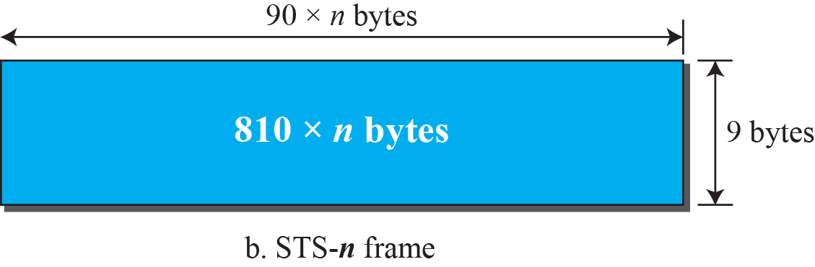
14.3.3 SONET Frames
Each synchronous transfer signal STS-n is composed of 8000 frames.
Each frame is a two-dimensional matrix of bytes with 9 rows by 90 × n columns.
An STS-1 frame is 9 rows by 90 columns (810 bytes), and an STS-3 is 9 rows by 270 columns (2430 bytes).

Slide 28
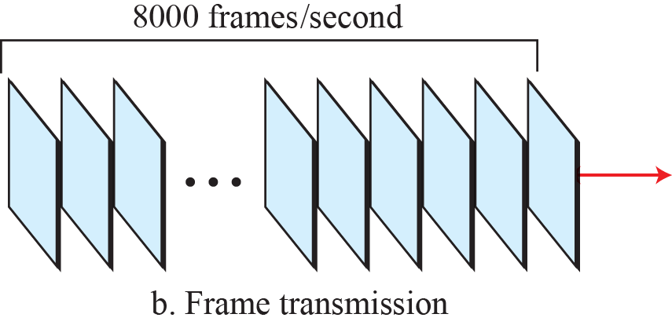
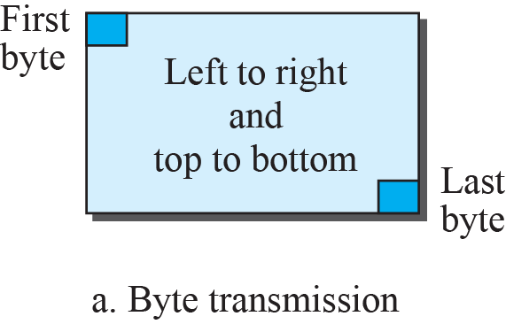
14.3.3 SONET Frames
STS-1 frames in transition
SONET STS-n 신호는 초당 8000 프레임으로 전송된다.

Slide 29
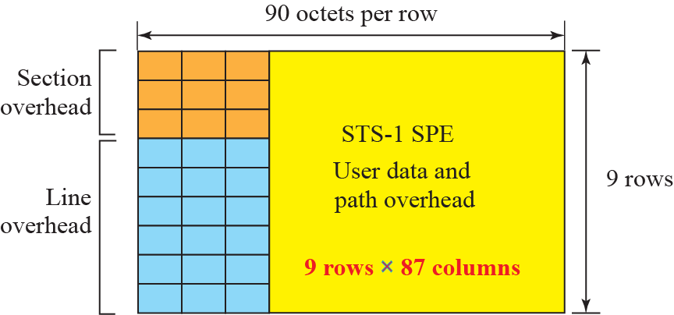
14.3.3 SONET Frames
STS-1 Frame Overheads

Slide 30
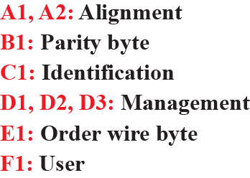
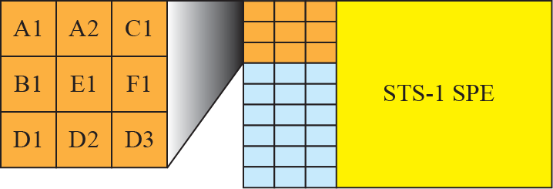
14.3.3 SONET Frames
STS-1 Frame : Section Overheads
구간 오버헤드는 각 SONET 장치에서 다시 계산된다
(재생기와 다중화기)

Slide 31
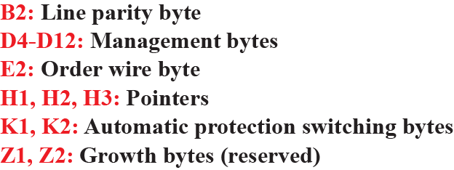
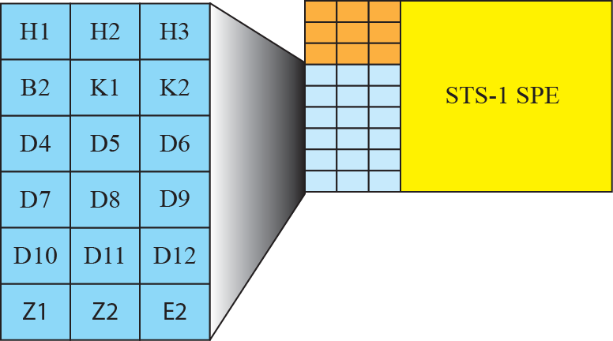
14.3.3 SONET Frames
STS-1 Frame : Line Overheads

Slide 32
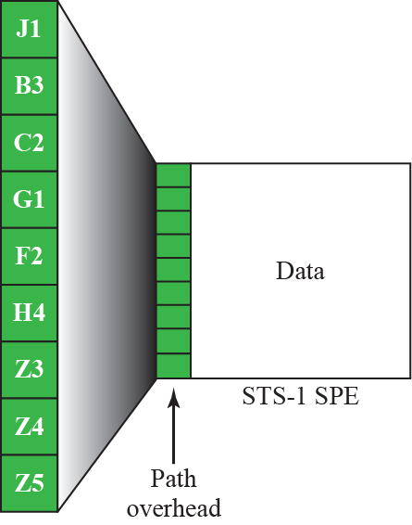
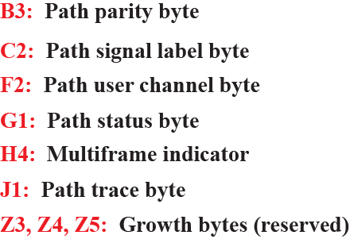
14.3.3 SONET Frames
STS-1 Frame : Path Overheads

Slide 33
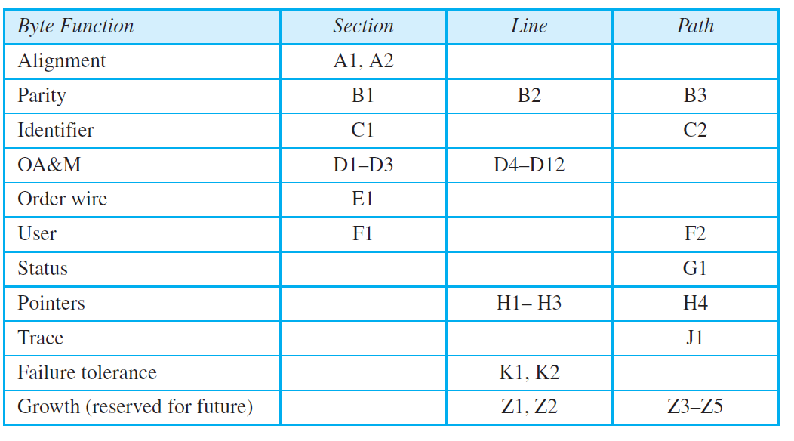
14.3.3 SONET Frames
표 14.2: SONET/SDH Overheads 요약

Slide 34
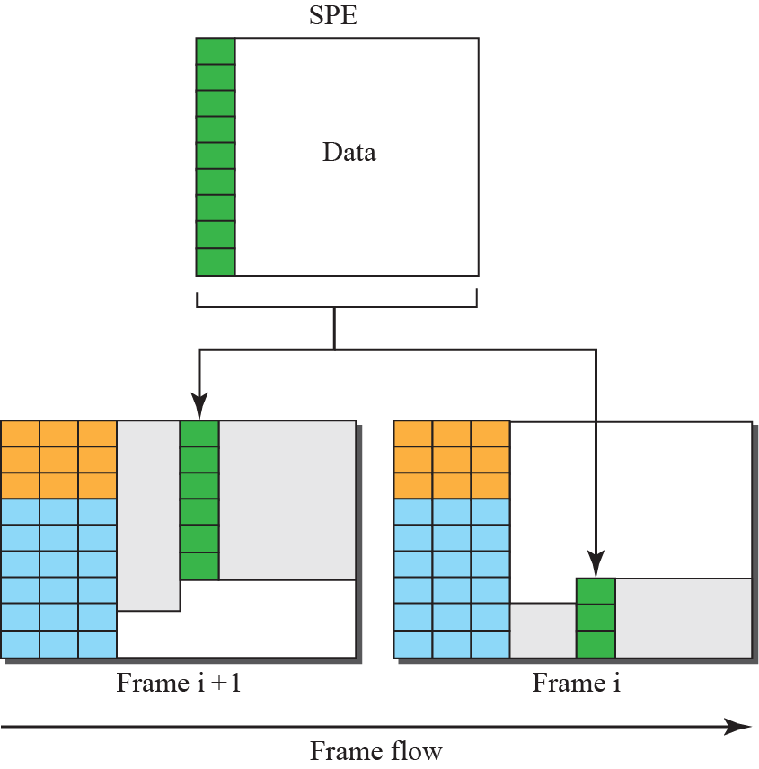
14.3.3 SONET Frames
Offsetting of SPE related to frame boundary

Slide 35
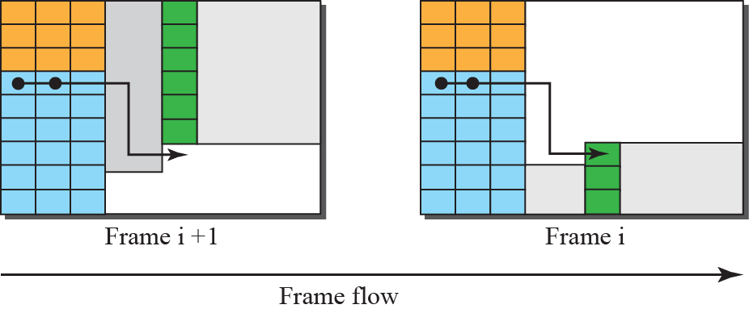
14.3.3 SONET Frames
The use of H1 and H2 to show the start of SPE

Slide 36
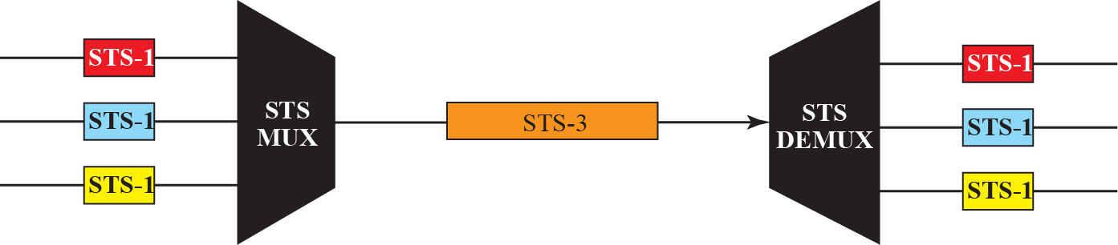
14.3.4 STS Multiplexing
STS Multiplexing/Demultiplexing
  낮은 전송율의 프레임들을 높은 전송율의 프레임으로 Synchronous Time Division Multiplexing
      예) 세 개의 STS-1 신호(채널)들은 하나의 STS-3 신호(채널)로 결합, 네 개의 STS-3는 하나의 STS-12로 다중화될 수 있다.
  다중화는 네트워크 내 모든 클록이 동기화를 달성하기 위해 하나의 마스터 클록에 맞춰짐

Slide 37
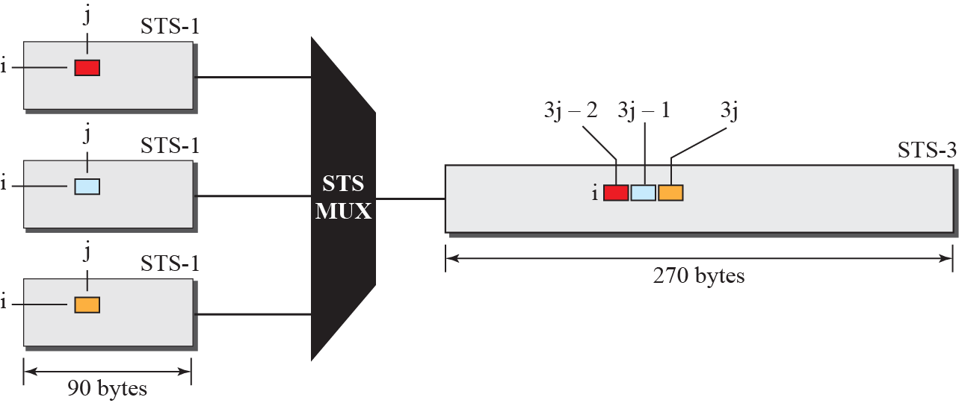
14.3.4 STS Multiplexing
Byte interleaving

Slide 38
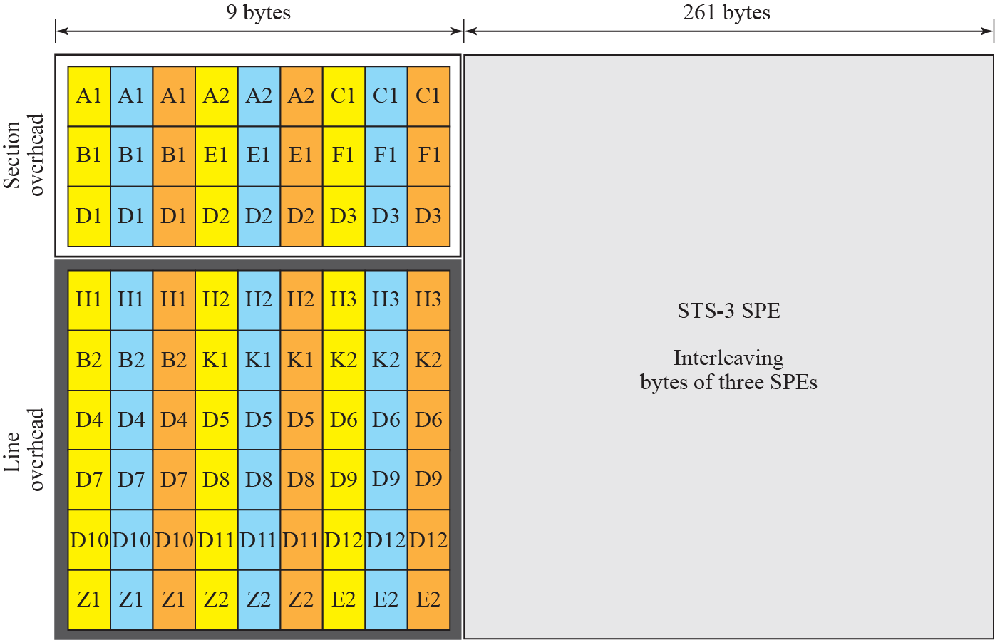
14.3.4 STS Multiplexing
An STS-3 frame

Slide 39
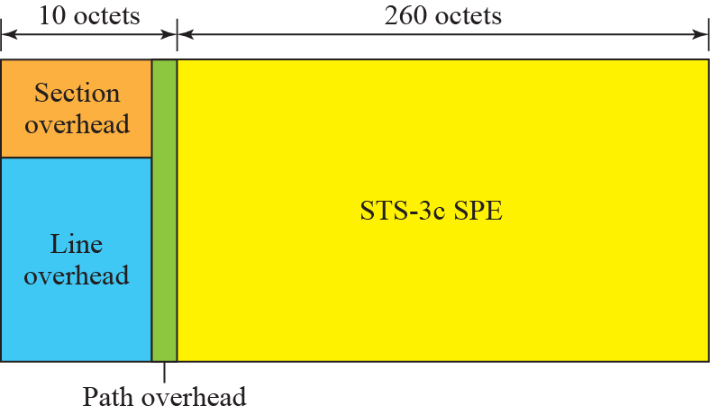
14.3.4 STS Multiplexing
A concatenated STS-3c signal

Slide 40
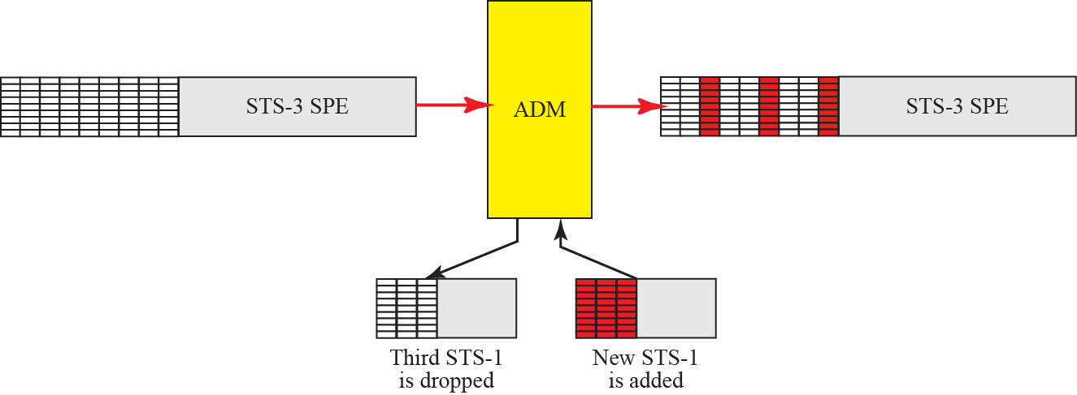
14.3.4 STS Multiplexing
Dropping and adding frames in an add/drop multiplexer

Slide 41
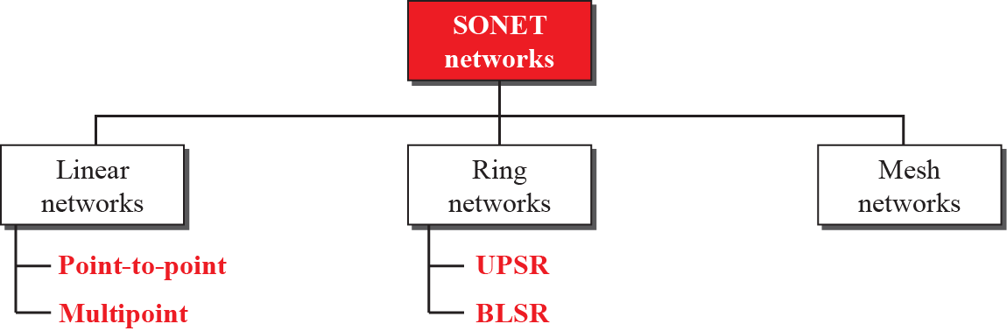
14.3.5 SONET Networks
Taxonomy of SONET networks

Slide 42
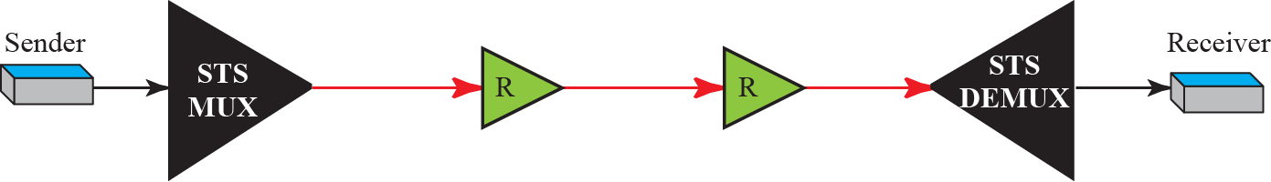
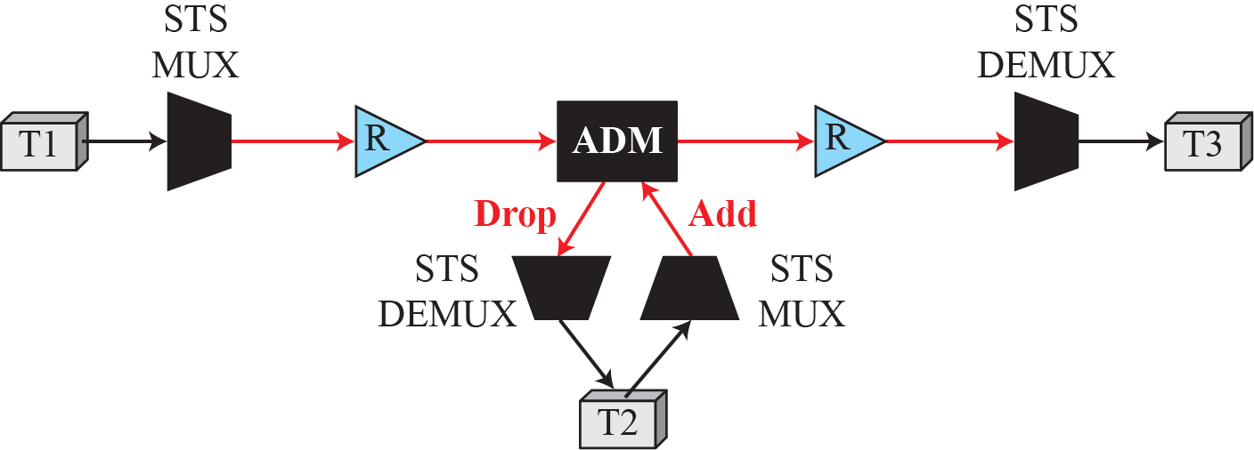
14.3.5 SONET Networks
A point-to-point SONET network
A linear SONET network

Slide 43
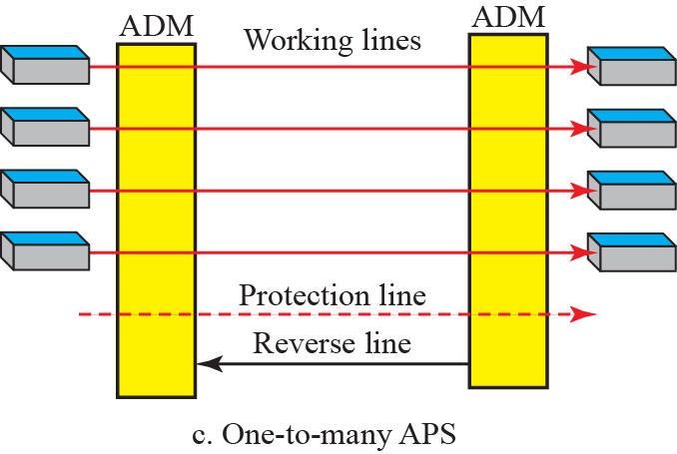
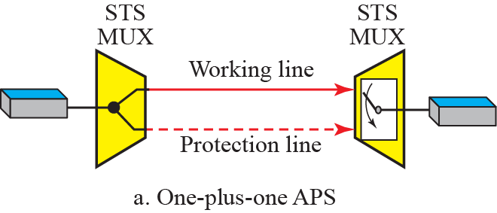
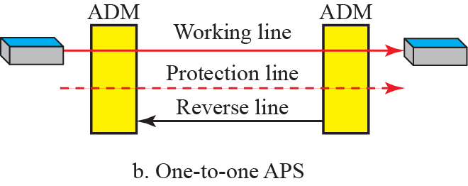
14.3.5 SONET Networks
Automatic Protection Switching (APS)
  선형 네트워크에서 고장에 대비하는 보호를 만들기 위함
  중복 회선(광섬유)이 주 회선이 고장 나는 경우에 사용된다.
Automatic protection switching in linear networks

Slide 44
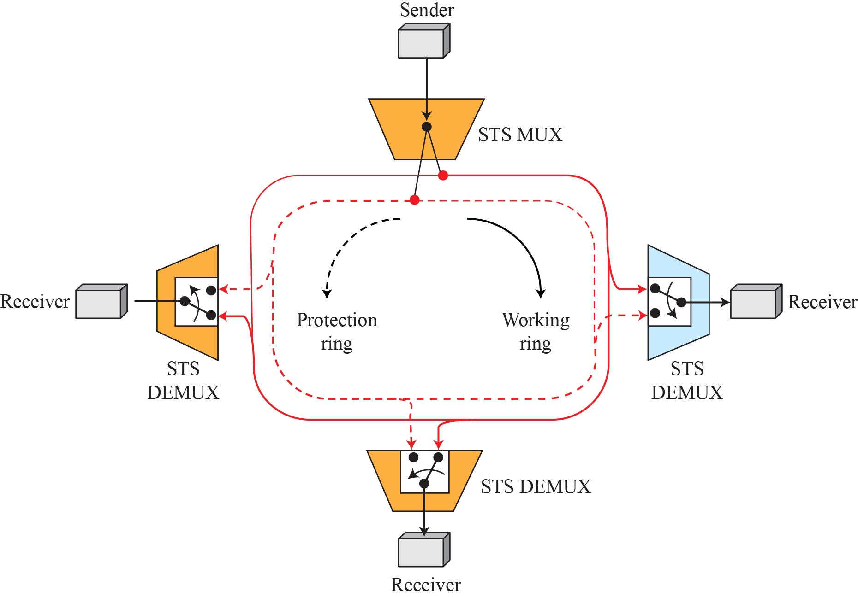
14.3.5 SONET Networks
A unidirectional path switching ring

Slide 45

14.3.5 SONET Networks
A bidirectional switching ring

Slide 46

14.3.5 SONET Networks
A combination of rings

Slide 47


14.3.5 SONET Networks
A mesh SONET network

Slide 48



14.3.6 Virtual Tributaries(VT)
Virtual Tributaries(VT)
  SONET과 현재의 계층구조의 호환성을 위함
VT 유형

Slide 49
14.4 ATM
Asynchronous Transfer Mode (ATM)
  ATM is "a telecommunications concept defined by ANSI and ITU standards for carriage of a complete range of user traffic, including voice, data, and video signals”.
  The combination of ATM and SONET will allow high-speed interconnection of all the world’s networks.
  ATM is a core protocol used over the SONET/SDH backbone of the public switched telephone network (PSTN) and Integrated Services Digital Network (ISDN),
  The use of ATM is declining in favor of all IP.

Slide 50
14.4.1 Design Goals
Design Goals of ATM
  The need for a transmission system to optimize the use of high-data-rate.
  The system must interface with existing systems.
  The design must be implemented inexpensively.
  The new system must be able to work with and support the existing hierarchies
  The new system must be connection-oriented.
  Last but not least, one objective is to move as many of the functions to hardware as possible.

Slide 51
14.4.2 Problems
혼합된 네트워크 트래픽
  다양한 프레임 크기는 트래픽을 예측할 수 없도록 한다.
  서로 다른 프레임 네트워크간의 네트워킹 지원에 어려움이 있다
  프레임의 크기에 상관없이 일관된 데이터 전송률을 지원해야 한다.
Cell Network
  프레임 인터네트워킹에서의 문제를 해결
  Cell : 고정된 크기의 작은 데이터 단위.
셀 네트워크는 데이터 교환의 기본단위로 셀을 사용한다.
셀은 작고 고정 크기의 블록의 정보로 정의된다.

Slide 52


14.4.2 Problems
Multiplexing using different frame size
Multiplexing using cells

Slide 53

14.4.2 Problems
Asynchronous TDM
  ATM은 셀들을 다중화 하기 위해 비동기 시분할 다중화를 사용
  고정된 크기(셀의 크기)의 틈새를 이용
ATM Multiplexing

Slide 54

14.4.3 Structures
ATM Cell Exchange Network
  Endpoint 장치는 네트워크 내 Switch에 User-to-Network Interface UNI)를 통해 연결.
  Switch 사이는 Network-to-Network Interface (NNI)를 통해 연결.

Slide 55

14.4.3 Structures
Virtual Connection
  Transmission Path (TP)
  Virtual Path (VP)
  Virtual Circuit (VC)

Slide 56


14.4.3 Structures
Identifier
  계층적인 경로지정을 허용
  Virtual Path Identifier (VPI) : 특정한 VP를 정의
  Virtual Circuit Identifier (VCI) : VP내 특정 VC 정의
UNI와 NNI에서의 가상 연결 식별자

Slide 57

14.4.3 Structures
Cell
  ATM에서 기본적인 데이터 단위
  53바이트로 구성되며, 헤더(5byte)+페이로드(48byte)
  헤더의 대부분이 VPI와 VCI로 채워짐
ATM Cell

Slide 58



14.4.3 Structures
Switch에서의 경로 지정

Slide 59


14.4.3 Structures
ATM Layer

Slide 60



14.4.3 Structures
응용 적용계층
  AAL, Application Adaptation Layer
  모든 종류의 페이로드, 연속 비트 스트림을 처리하기 위함
  SAR(Segmentation And Reassembly)
  CS(Convergence Sublayer): 데이터 무결성 보장
그림 14.49: AAL5

Slide 61

14.5 요약
Telephone Network
  How the voice network has been used for data transmission either as a dial-up or DSL service.
Cable Network
  How the video network has been used for data transmission.
SONET
  How the fiber-optic technology can be used for high-speed connection to carry data.
ATM
  ATM use SONET as the carrier to create a high-speed wide area network(WAN).
  ATM is a cell-relay network that uses a fixed-size frame (cell) as the unit of transmitted data.

